Slide 1

ECG Kit App Development
Final Presentation
조정희, 최윤호, 김준형, 박범순

Slide 2
Contents
Member Introduction & Development Story
2. Front-end Implementation
3. Back-end Implementation
4. Finishing app development

Slide 3


Member Introduction
1
2
3
4
Member Introduction & Development Story
Front End
Developer
UI Design, Documentation,
Chart Implementation
Park Beom Soon
BT Connection, Data Transmission,
Overall Function Implementation
Choi Yun Ho

Slide 4




Member Introduction
1
2
3
4
Member Introduction & Development Story
Back End
Developer
Main Director, Full-Stack Developer
Cho Jeong Hui
Server Management
Kim Jun Hyeong

Slide 5
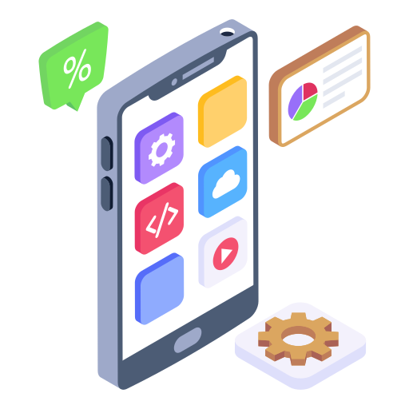
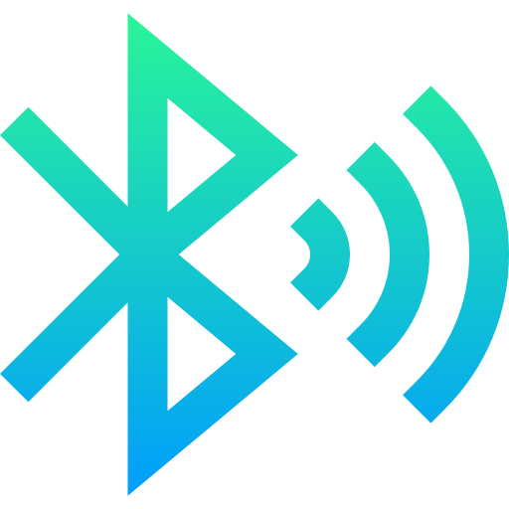
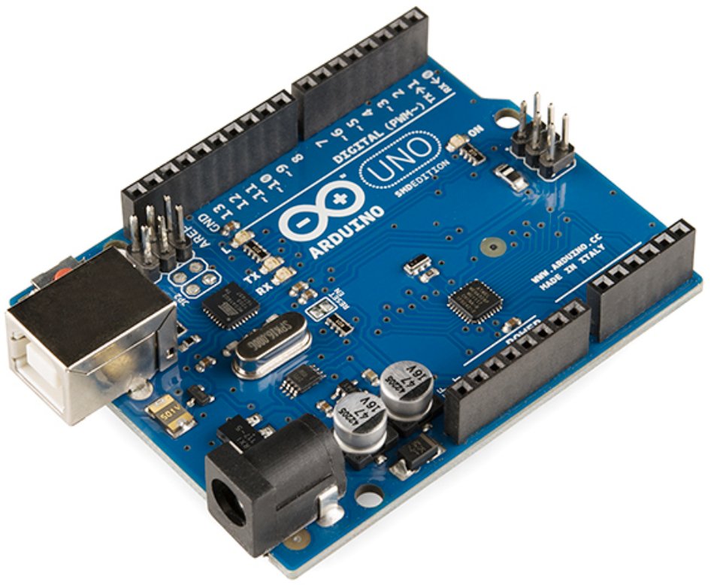
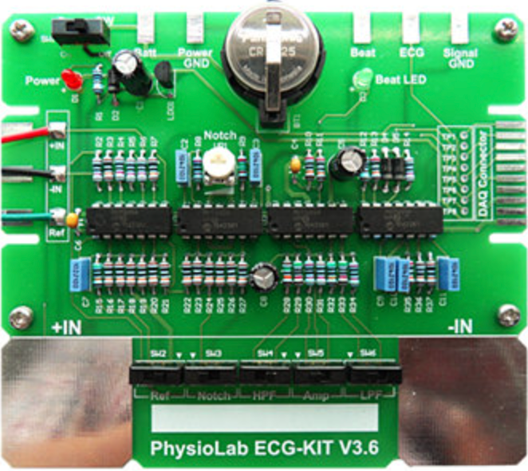
1st Mission
1
2
3
4
Member Introduction & Development Story
Transfer the measured data to the app through BT connection using Arduino UNO

Slide 6

Initial Plan
1
2
3
4
Member Introduction & Development Story
A week left until the deadline..
What programming language?
What should do with those data?
How can we transfer the data through BT?
How do we compose the app?

Slide 7

Initial Solution
1
2
3
4
Member Introduction & Development Story
Divide into 2 teams
(Front-End / Back-End)
One and only RULE
: Always be punctual
and responsible
App Development : Android Studio
Server (Database)
: Django
App Contents
① Examine the user’s status
② Show the result with the chart
③ Store the user’s results
The most significant
and difficult to implement
: BT Connection

Slide 8
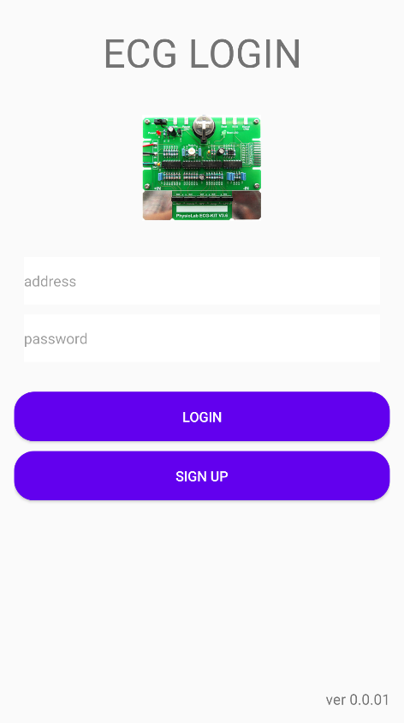

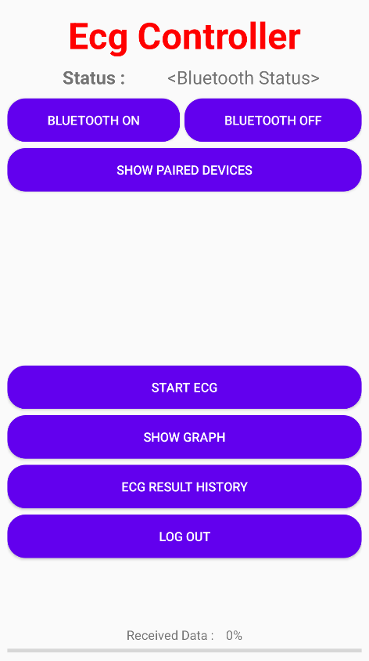
But..
1
2
3
4
Member Introduction & Development Story
Well done within the short time
But, POOR DESIGN
Prof. Kim
Your team adds more information such as meteorological information and upgrade the app

Slide 9
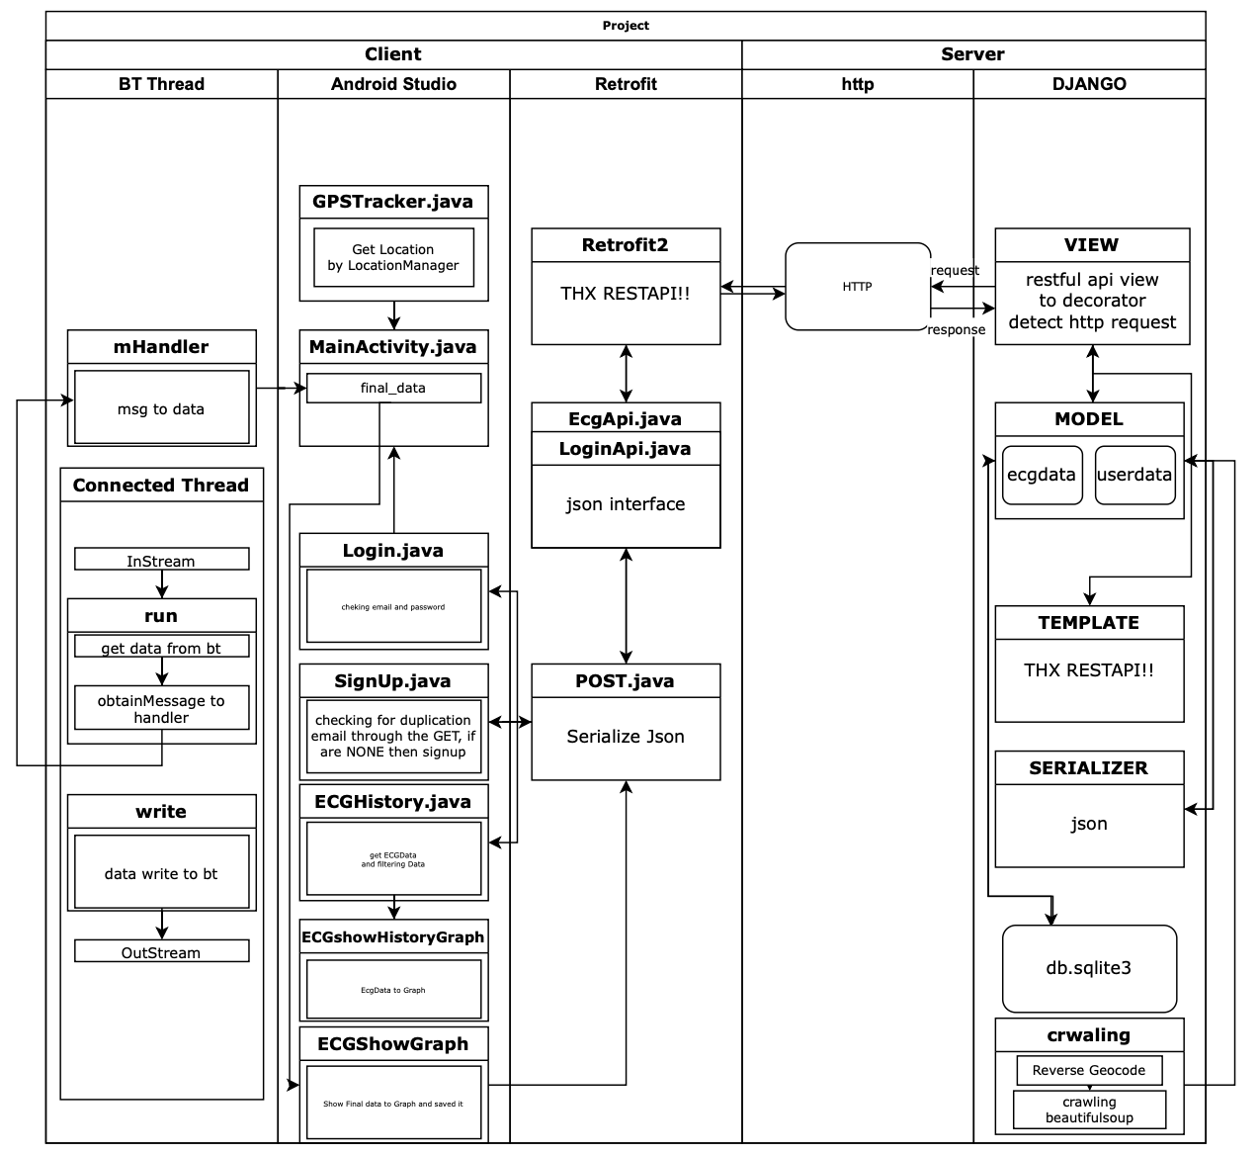
Our Final Application
1
2
3
4
Member Introduction & Development Story

Slide 10
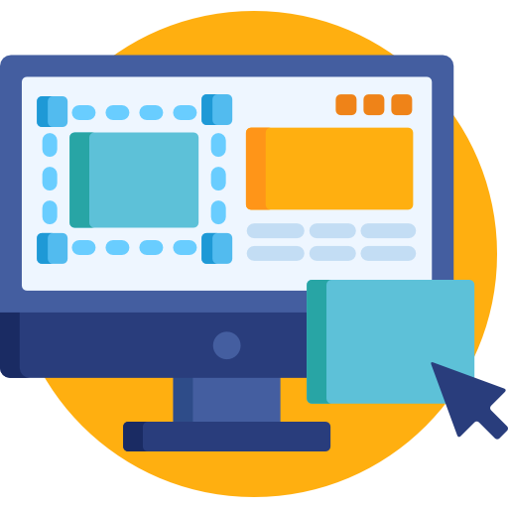

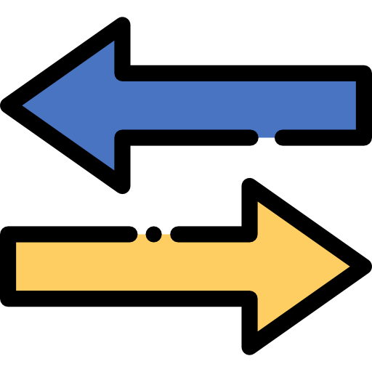
Terminology
1
2
3
4
Front-end Implementation
Client
Server
Request for service
Provide Service in response

Slide 11
Terminology
1
2
3
4
Front-end Implementation
Client
Server
Request for service
Provide Service in response
= Application
= Database

Slide 12



Terminology
1
2
3
4
Front-end Implementation
Front-end
Back-end
What you CAN see from the display
(Overall Layout)
What you CANNOT see from the display
(Data Management)

Slide 13
Terminology
1
2
3
4
Front-end Implementation
Front-end
Back-end
Full-stack
What you CAN see from the display
(Overall Layout)
What you CANNOT see from the display
(Data Management)

Slide 14
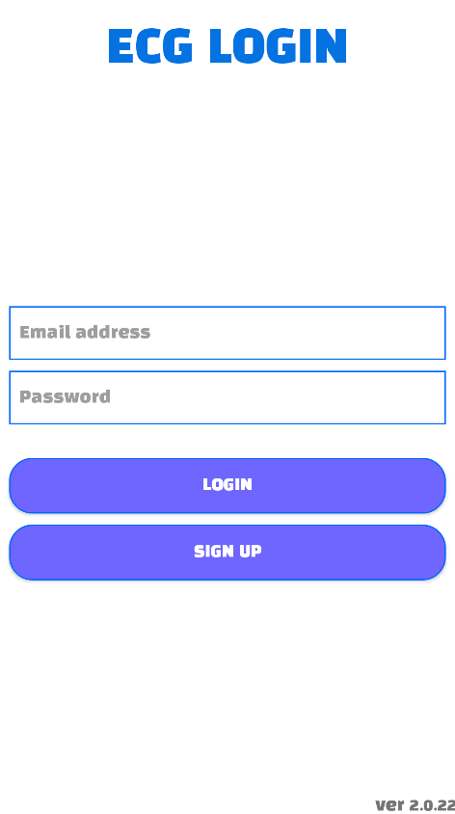

Login Activity
1
2
3
4
Front-end Implementation
Title : TextView
GIF File (ImageView)
EditTextView
(Enterring Email / PW)
Relative
Layout
Login (Button)
Register (Button)

Slide 15
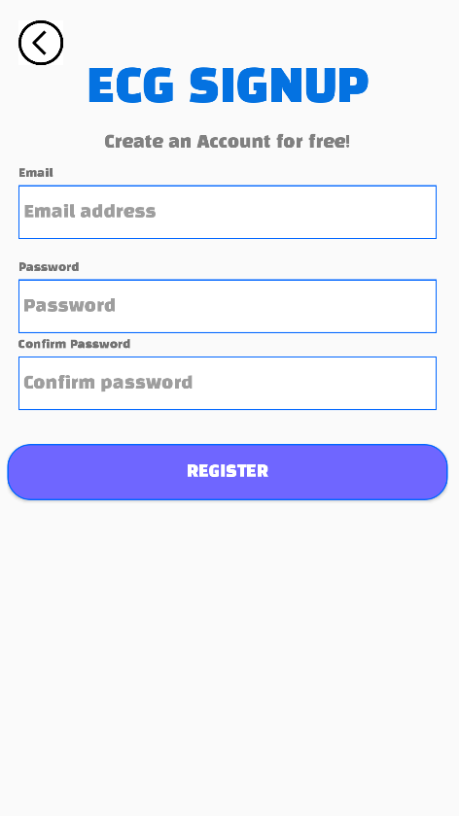
SignUp Activity
1
2
3
4
Front-end Implementation
(Sub)Title : TextView
EditTextView
(Enterring Email / PW)
Relative
Layout
Enter PW 1 more time
Register (Button)

Slide 16
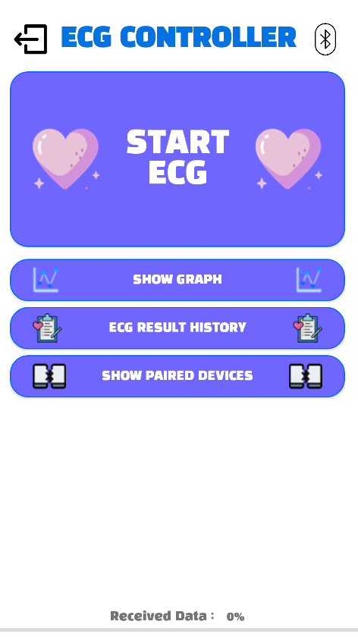
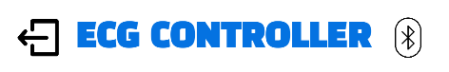
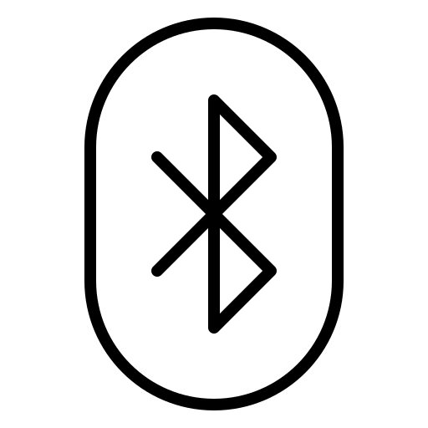
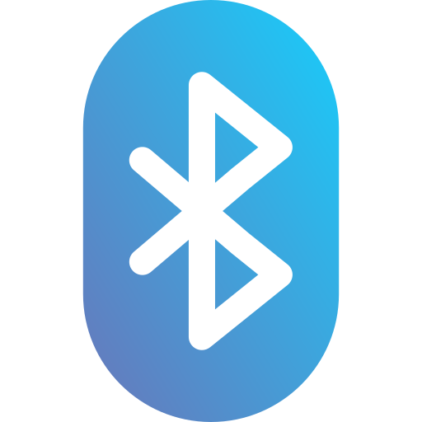

MainActivity
1
2
3
4
Front-end Implementation
Setting Image View
Title (TextView)
: Bluetooth Off
: Bluetooth On
Logout Button (ImageButtonView)
: Pairing Success

Slide 17
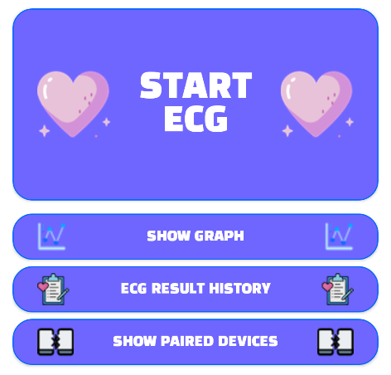
MainActivity
1
2
3
4
Front-end Implementation
Start ECG (Button)
① Get Location Access Permission
② Start getting data from arduino

Slide 18
MainActivity
1
2
3
4
Front-end Implementation
Show Graph (Button)
(After receiving data from arduino)
∙ Transmit the result to make the chart
∙ Go to another activity (Use intent)

Slide 19
MainActivity
1
2
3
4
Front-end Implementation
ECG Result History (Button)
∙ Go to another activity (Use intent)
∙ Get the user’s previous data from database

Slide 20
MainActivity
1
2
3
4
Front-end Implementation
Show Paired Device (Button)
∙ Only clickable when BT turned on
∙ Pairable devices shown
(Use Broadcast Receiver)
∙ Click specific remote device
→ Pair Success

Slide 21
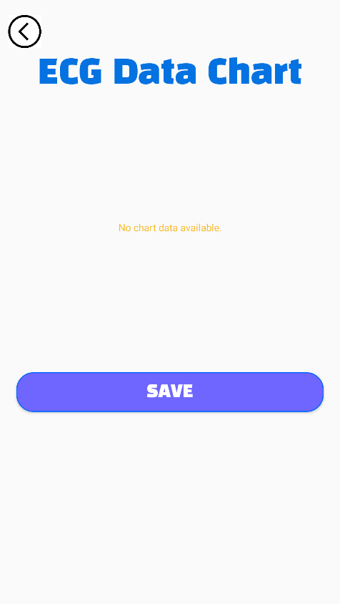
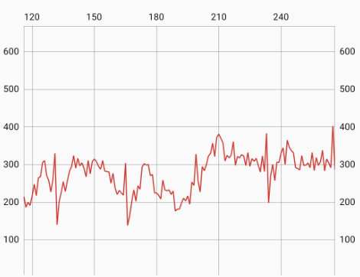
ECG Result Activity
1
2
3
4
Front-end Implementation
Result Chart (LineChart)
∙ By pressing Save Button, Not only measured data, but also data-collected time and location are transmitted and stored at the server
(※ Refer to PhilJay/MPAndroidChart)
Save (Button)

Slide 22
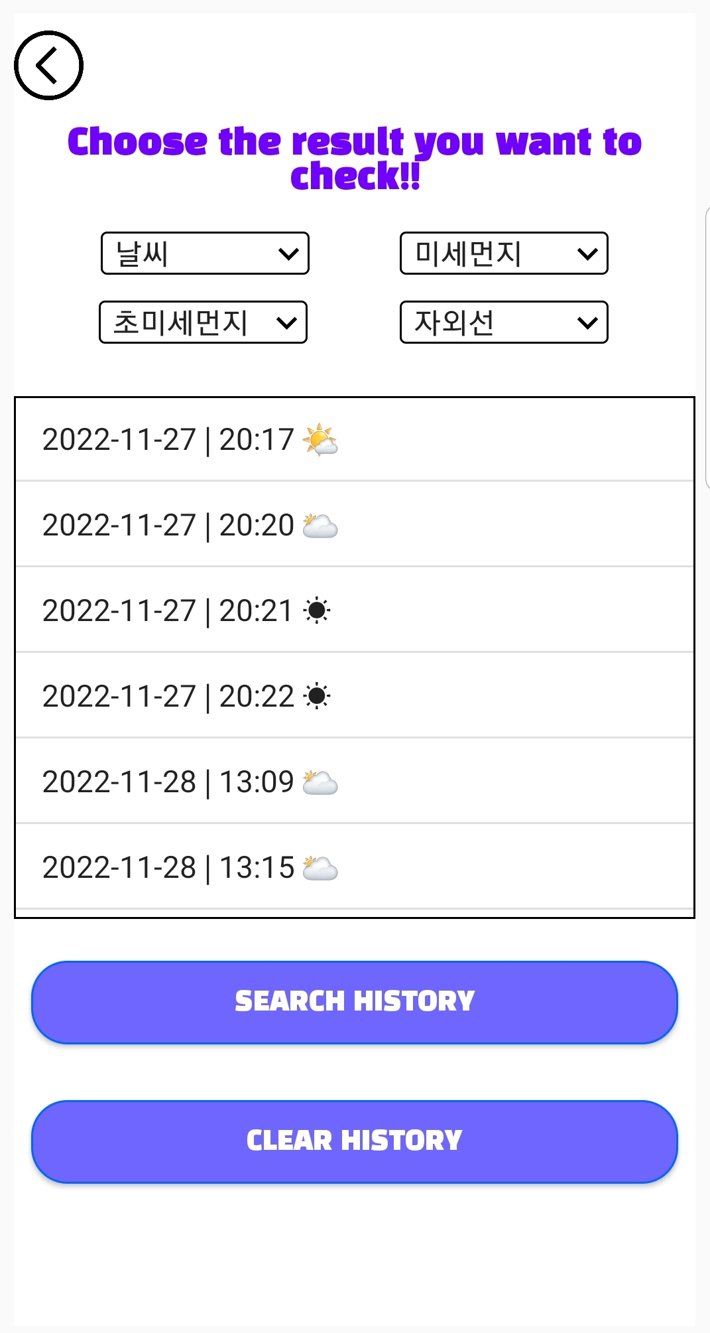
ECG History Activity
1
2
3
4
Front-end Implementation
Weather Filter (Spinner)
∙ When Search History Button Clicked,
user’s all previous results are displayed.
∙ User can filter the specific results according to the weather conditions that he/she has selected.
History List (ListView)
Search History (Button)
Clear History (Button)
(※ Temporarily remove data)

Slide 23

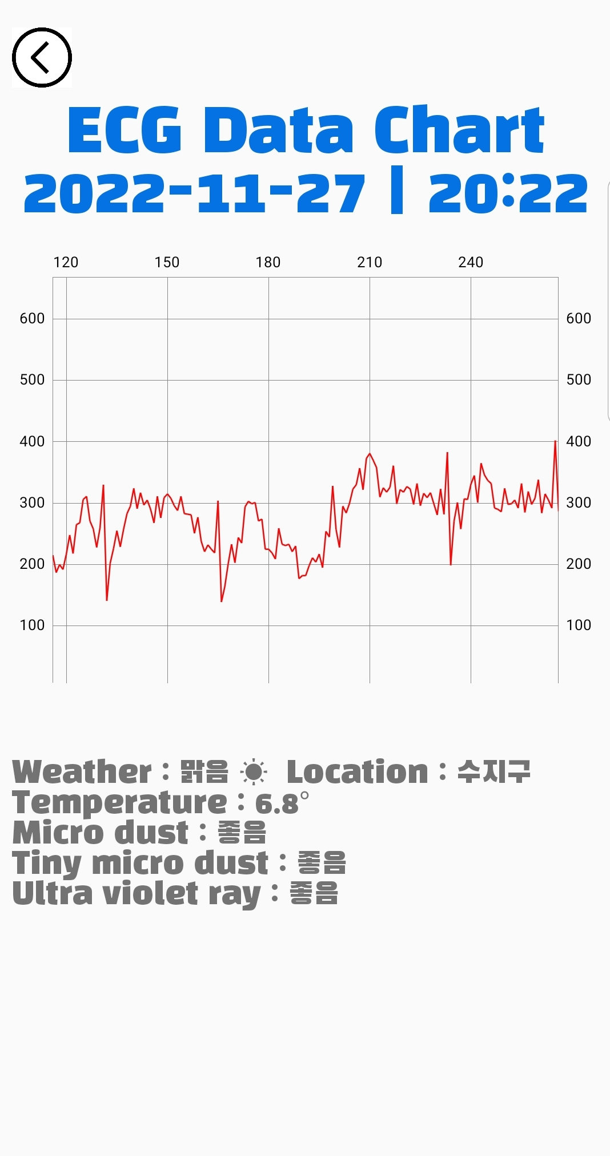
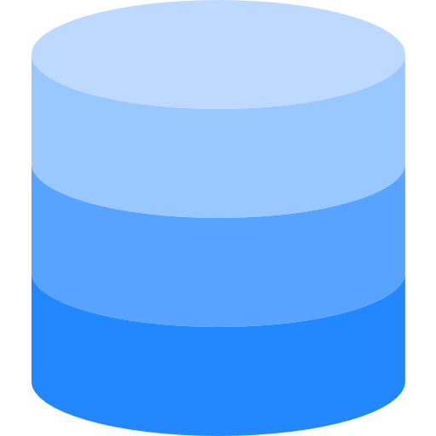
Weather information
1
2
3
4
Front-end Implementation
Android Studio provides classes
accessing the system location services
Location, LocationManager, LocationListener
Location Information
(Latitude / Longitude)
Converted into
Korean address
Allow access to manage
device location
Measured data & Location Information transferred to the server

Slide 24
ECG History Graph Activity
1
2
3
4
Front-end Implementation
Title/Date (TextView)
∙ Get the weather information of the location of selected data from the server
and display it on the screen
Result Chart (LineChart)
※ Weather information were retrieved
by using ‘Web Crawling’
Weather (TextView)

Slide 25
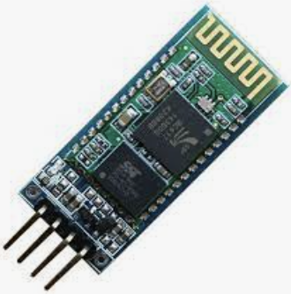

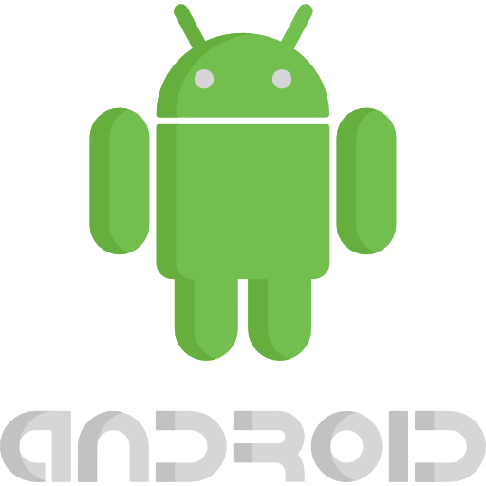
Bluetooth Connection
1
2
3
4
Front-end Implementation
HC06
How to transfer the data?
Application
Arduino UNO

Slide 26
Bluetooth Connection
1
2
3
4
Front-end Implementation
Complete the initial setting of HC06
UART Communication
1. Make reverse of the pin numbers of Tx & Rx in Arduino and those in HC06
(At Serial Monitor)
2. Set BT module name & PIN Number using ‘AT’ Command
HC06
3. Activate BT and check the connection between
HC06 & the device
Arduino UNO

Slide 27
Bluetooth Connection
1
2
3
4
Front-end Implementation
Bluetooth Adapter
+Adapter View
Client
Server
Bluetooth Socket
BroadcastReceiver
Application
HC06
Thread
Handler

Slide 28







Bluetooth Connection
1
2
3
4
Front-end Implementation
Bluetooth Adapter
+Adapter View
Client
Server
Bluetooth Adapter
- Basically android studio contains ‘Bluetooth’ class
- Help to utilize the fundamental Bluetooth functions
Bluetooth Socket
Thread
Bluetooth Adapter
BroadcastReceiver
HC06
Output
Stream
Application
HC06
Thread
Input
Stream
Pairable
Devices
BT Socket
BT Adapter Array
Handler

Slide 29
Bluetooth Connection
1
2
3
4
Front-end Implementation
Bluetooth Adapter
+Adapter View
- Array for storing the information of pairable devices
- When you activate BT of your device,
it receives the data of each pairable device
Client
Server
BT Adapter Array
Bluetooth Socket
Thread
Bluetooth Adapter
BroadcastReceiver
HC06
Output
Stream
Application
HC06
Thread
Input
Stream
Pairable
Devices
BT Socket
BT Adapter Array
Handler

Slide 30
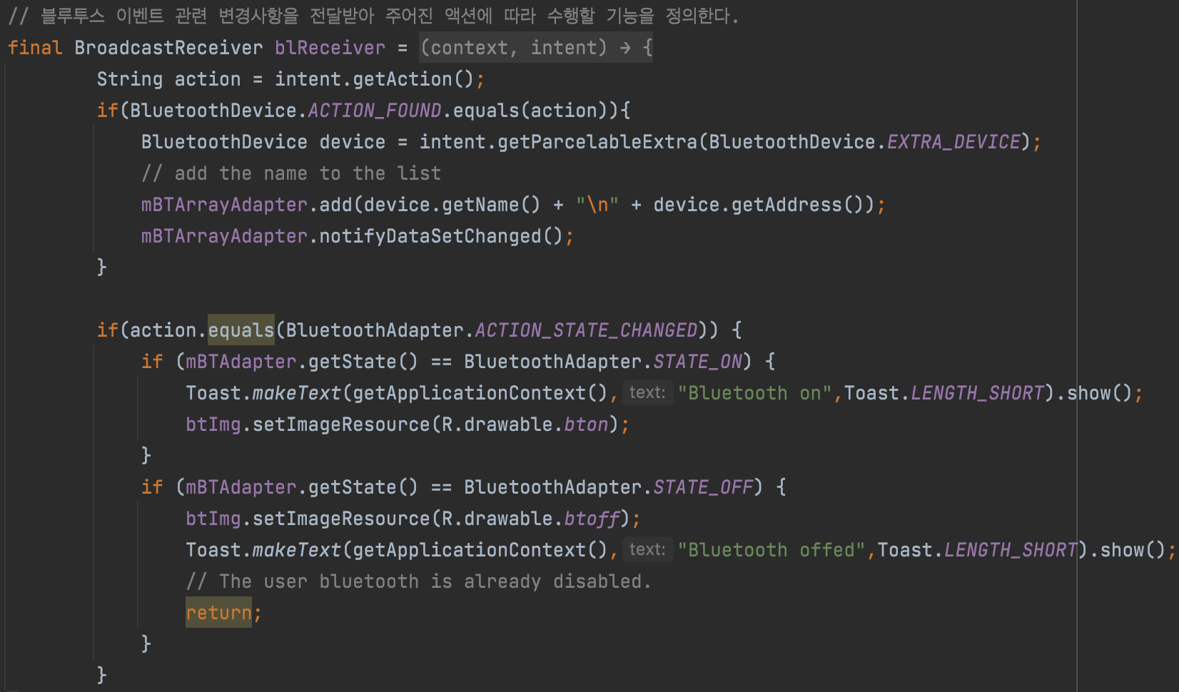
Bluetooth Connection
1
2
3
4
Front-end Implementation
BroadcastReceiver
Bluetooth Adapter
+Adapter View
Client
Server
It receives any change about Bluetooth events happening in the app
→ Define the tasks depending on the given actions
Bluetooth Socket
BroadcastReceiver
Application
HC06
Thread
Handler

Slide 31
Bluetooth Connection
1
2
3
4
Front-end Implementation
Bluetooth Adapter
+Adapter View
- Interface for the bluetooth communication
- Connection is created through the socket
- After the connection is created,
Transmission & Receipt becomes available (like TCP)
Client
Server
Bluetooth Socket
Bluetooth Socket
Thread
Bluetooth Adapter
BroadcastReceiver
HC06
Output
Stream
Application
HC06
Thread
Input
Stream
Pairable
Devices
BT Socket
BT Adapter Array
Handler

Slide 32
Bluetooth Connection
1
2
3
4
Front-end Implementation
Bluetooth Adapter
+Adapter View
- Through the socket, BT communication is available
- Input Stream : Sequence of received data (Kind of Buffer)
- Output Stream : Sequence of data to be transmitted
(Same as above)
Client
Server
Input / Output Stream
Bluetooth Socket
Thread
Bluetooth Adapter
BroadcastReceiver
HC06
Output
Stream
Application
HC06
Thread
Pairable
Devices
Input
Stream
Pairable
Devices
BT Socket
BT Adapter Array
Handler

Slide 33
Bluetooth Connection
1
2
3
4
Front-end Implementation
Bluetooth Adapter
+Adapter View
- Through the socket, BT communication is available
- Input Stream : Sequence of received data (Kind of Buffer)
- Output Stream : Sequence of data to be transmitted
(Same as above)
Client
Server
Input / Output Stream
Bluetooth Socket
We are going to deal with these data
(Transferred from Arduino UNO
through BT communication)
Thread
Bluetooth Adapter / Array Adapter
BroadcastReceiver
HC06
Output
Stream
Application
HC06
Thread
Input
Stream
Pairable
Devices
BT Socket
BT Adapter Array
Handler

Slide 34
Bluetooth Connection
1
2
3
4
Front-end Implementation
Bluetooth Adapter
+Adapter View
Client
Server
- The segment of a process (Program being executed in the main memory)
- One process has one or more threads
- Main Activity in Android Studio
→ One process executed with a single thread (Default)
Thread
Bluetooth Socket
BroadcastReceiver
Want more various functions to be executed at background?
Create and define more threads on your own!
Application
HC06
Thread
Handler

Slide 35
Bluetooth Connection
1
2
3
4
Front-end Implementation
Problems with multi threads
Race Condition
: 2 or more threads try to access shared resource
Bluetooth Adapter
+Adapter View
Simultaneously
Client
Server
Thread 1
Make it Red!
We can do more
with many threads!!
Button in MainActivity
Bluetooth Socket
Thread 2
Make it Blue!
BroadcastReceiver
DeadLock : 2 or more threads hold certain resource respectively and waiting for other thread to release the lock of their resource
Then how would you HANDLE those threads?
Application
HC06
Thread
Hold
Button
Wait
Thread 1
(Waiting forever)
Thread 2
Handler
Wait
Image
Hold

Slide 36
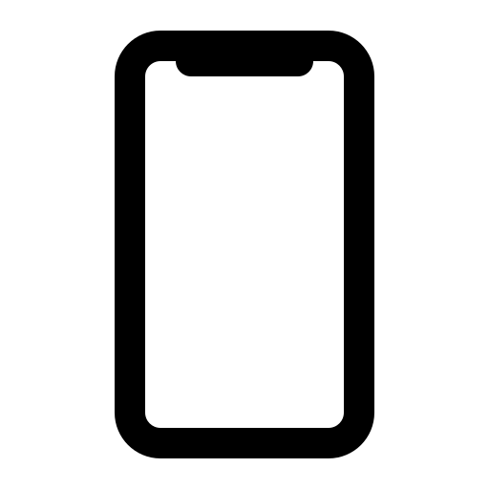





Bluetooth Connection
1
2
3
4
Front-end Implementation
Handler
Bluetooth Adapter
+Adapter View
MainActivity
Client
Server
(Message, Runnable object)
Message Queue
A queue composed of tasks that will be executed in a certain thread
- 1 Message Queue is assigned to 1 Thread
- Send & process message or runnable object associated with the thread (Tasks represented in thread should be conducted through the handler)
- To avoid the undesirable problems in the previous slide, 1 handler to 1 thread is necessary
Message
Bluetooth Socket
Message
Handler
BroadcastReceiver
Message
Message.obtainMessage()
Application
HC06
Thread
Thread
Message
Message
Handler
Message.sendToTarget()

Slide 37
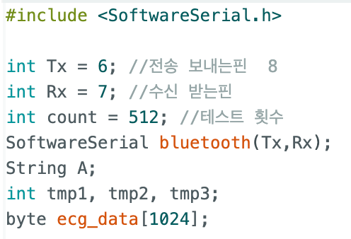
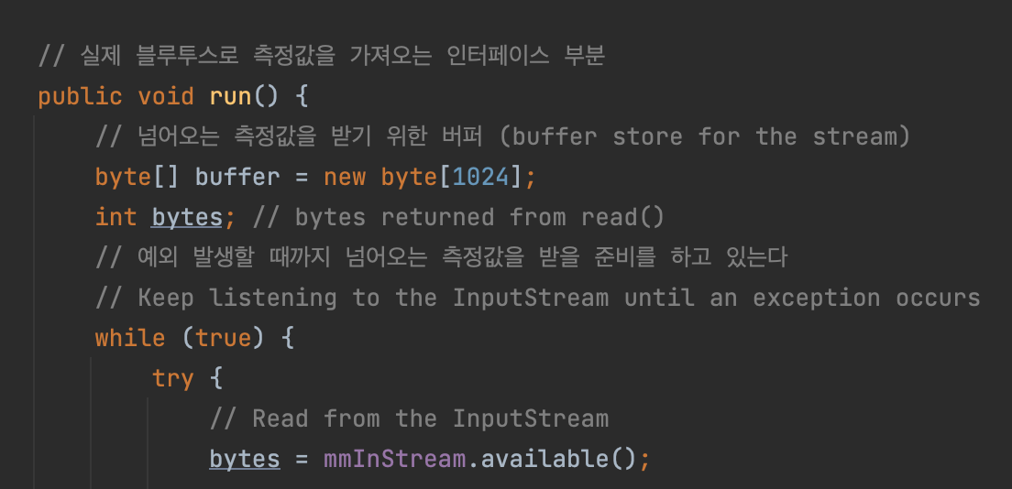
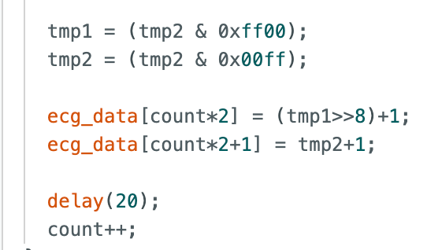
Data Transfer
1
2
3
4
Front-end Implementation
Byte Array
Bluetooth Adapter
+Adapter View
Client
Arduino IDE
Server
Android Studio
Bluetooth Socket
Transmission is ONLY available using byte array
BroadcastReceiver
Application
HC06
Thread
Handler

Slide 38
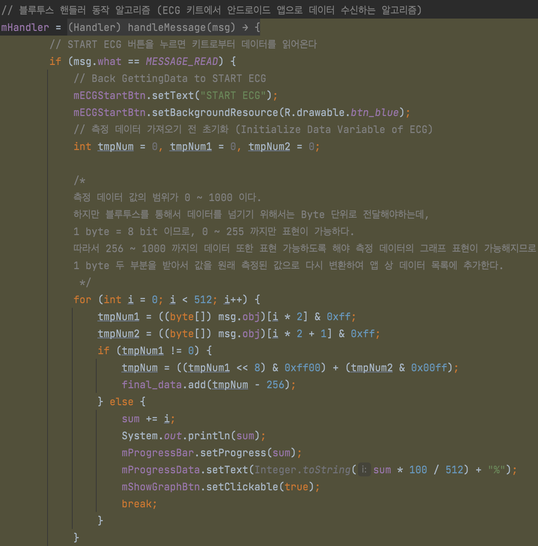
Data Transfer
1
2
3
4
Front-end Implementation
How to transfer data with this data type?
Bluetooth Adapter
+Adapter View
Client
Server
Data Stream : [124, 235, 82, 351, 455, 92, 90, 43, … ]
Bluetooth Socket
BroadcastReceiver
1 Byte = 8 bit → (0 ~ 2⁸ - 1)
2 bytes are needed to represent value over 255
Value > 255 : n * 2⁸ + m
0 ≤ Value ≤ 255 : 0 * 2⁸ + m
(n, m : consecutive 2 elements in byte array)
Application
HC06
Thread
Handler

Slide 39
Data Transfer
1
2
3
4
Front-end Implementation
Thread
Bluetooth Adapter / Array Adapter
HC06
Output
Stream
Input
Stream
Pairable
Devices
BT Socket
BT Adapter Array

Slide 40


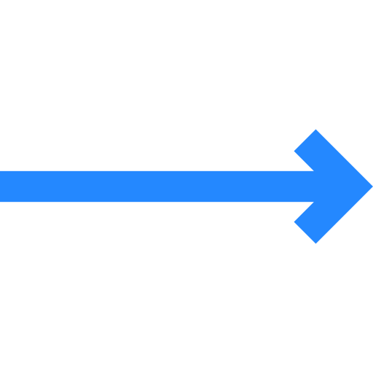



Data Transfer
1
2
3
4
Front-end Implementation
Display Chart
Thread
Output
Stream
Measured Data
Data Buffer
Input
Stream
BT Socket
Store it in our server

Slide 41

Basic Concept
1
2
3
4
Back-end Implementation
: OpenSource Python Web framework
(Support common Web Development needs)
- MVT Pattern Model : Hold data interacting with database
View : Handle HTTP Request/Response directly and
work as a bridge of Model & Template
Template : provide user interface
HOWEVER, we will use it as a web server by using REST API

Slide 42
Basic Concept
1
2
3
4
Back-end Implementation
REST API : helps Django to be implemented as either client or server
↳ Replace the role of ‘View’
(Handle responses directly with HTTP request ‘method’ C.R.U.D.)
(Parameter)
C.R.U.D. = Create / Read / Update / Delete
- POST(Create) : Store data at the server
- GET(Read) : Return the requested data
- PUT(Update) : Update data
- DELETE(Delete) : Delete data

Slide 43


Overall Data Flow
1
2
3
4
Back-end Implementation
Server
Application
Application
Data Request
Model
View
HTTP Request
Template
Serializer
Serializer
REST API
(POST Class)
HTTP Response
Application
Data Receipt
Thanks to REST API, we can observe the logic and entire data stored in our web server through template
※ Serializer : Change the form of data into JSON file and conduct transfer through HTTP protocol

Slide 44
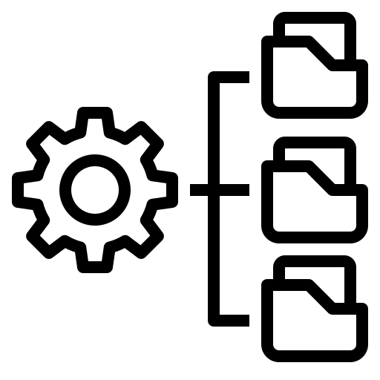
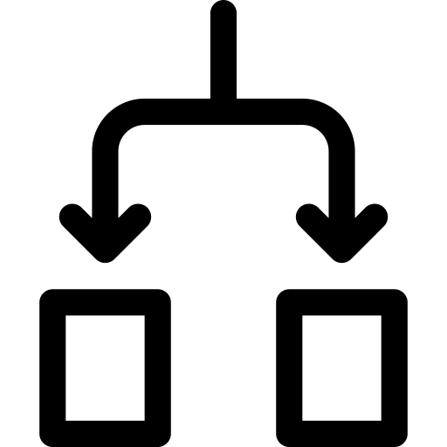

Lessons from this project
1
2
3
4
Finishing app development
1. Importance of sophisticated design
2. (At most) 1 event assignment per function
3. Necessity of searching skill for valid information

Slide 45
Thank you

